Slide 1
A Secure Pub-Sub System
Erasmus Mundus Masters in Green Networking and Cloud Computing (GENIAL)
Mini-Project - Network Programming and Distributed Applications
Luleå University of Technology
October 24, 2022
Group Members:
Do Ha Long
John Wannerkawahara
Pavan Karnati
Arsalan Ahmed
Course Professor:
Dr. Evgeny Osipov

Slide 2
Outline
Motivation
Proposal
Architectural Design
System Flow
Data Chunk Structure
Performance Evaluation
Conclusion & Demo

Slide 3
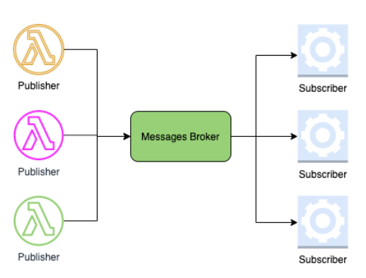
Motivation
Publish-subscribe is a popular asynchronous message exchange pattern that is widely used in distributed systems.
The pub-sub model has its own share of security issues.
Anonymity or identity protection of the publishers and subscribers is a major concern!
Problem Statement
There should be an efficient way to protect the identities of both the publishers and subscribers from each other, from outside parties, and from the entities that handle the implementation of the pub/sub system.

Slide 4
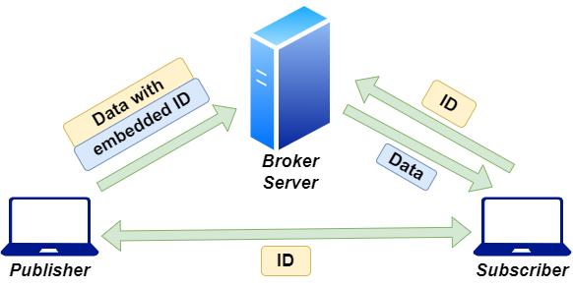
Proposal
Secure Pub/Sub System

Slide 5
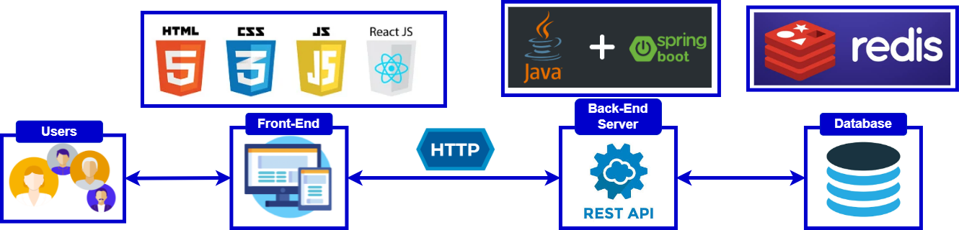
Architectural Design

Slide 6
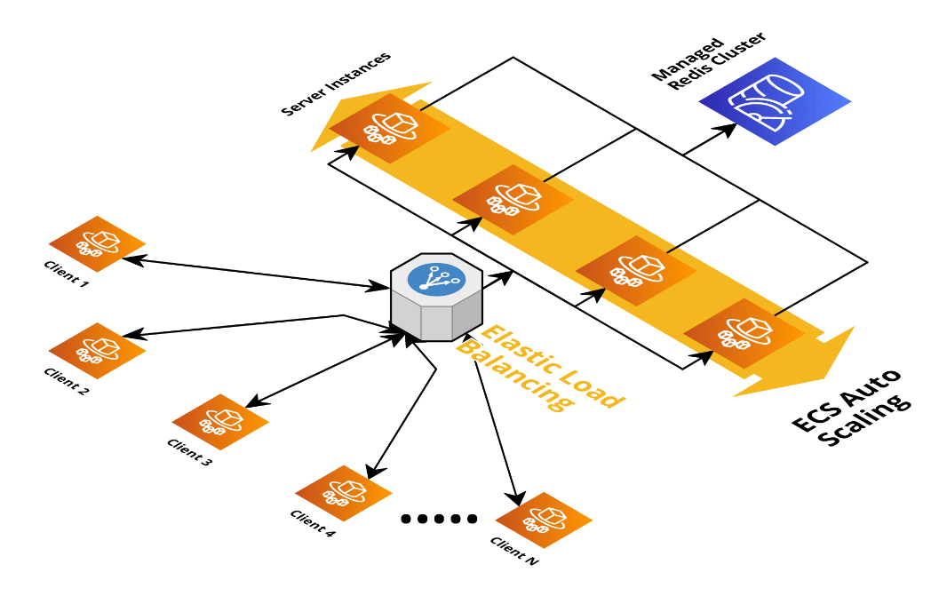
Scalable Architecture

Slide 7
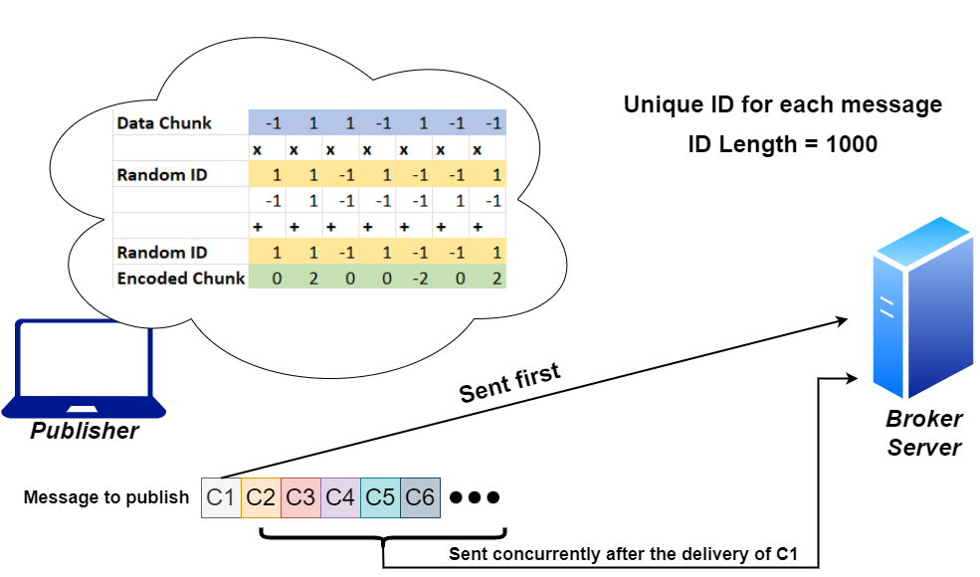
System Flow - Publishing Client

Slide 8
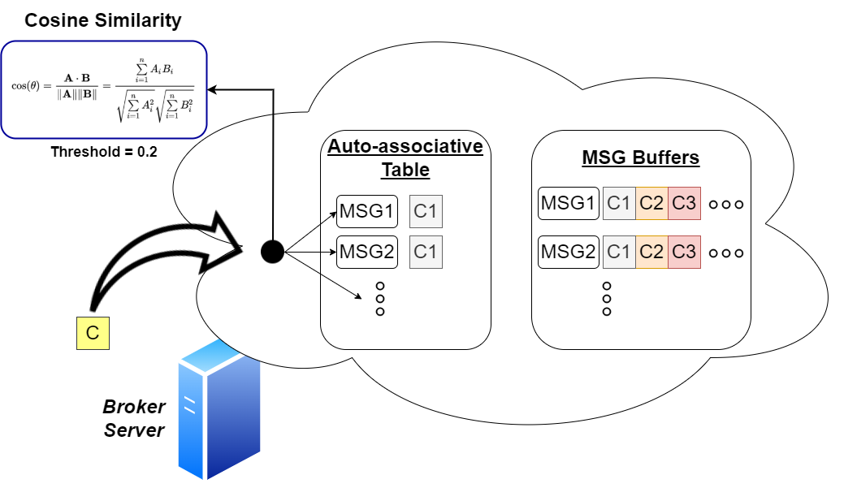
System Flow - Broker Server

Slide 9
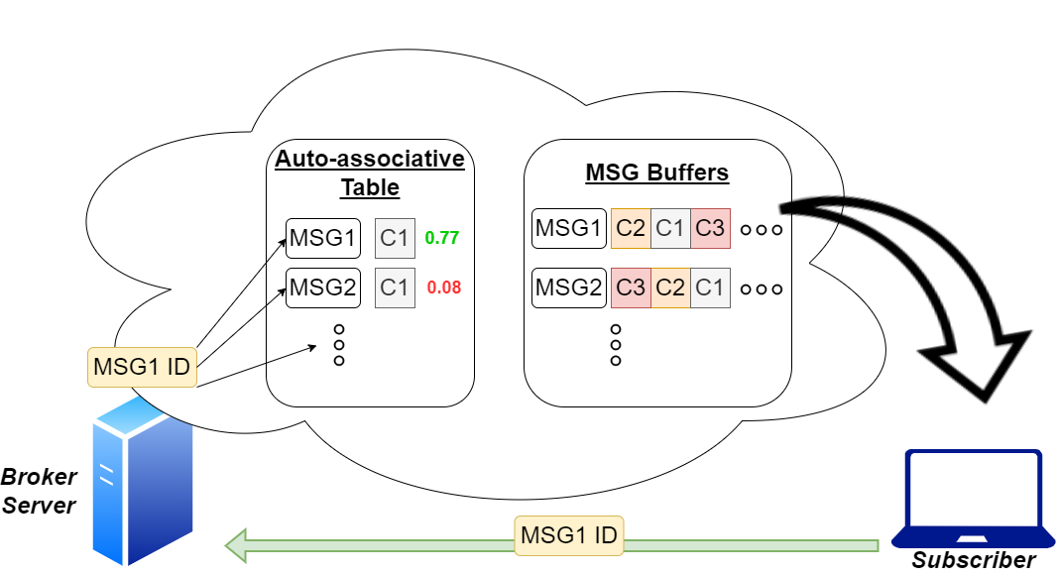
System Flow - Subscriber Client

Slide 10
Data Chunk Structure
Need of reordering the data chunks at the subscriber.
Requirement of informing the subscriber about the length of the message as the length may not be perfectly divisible by the ID length (1000).
Sequence Number
Data Length
Actual Data
0
9
10
19
20
999
2^10 = 1024 data chunks possible in a message
8 elements for a single character, therefore, 122.5 characters in a chunk
1024 * 122.5 = 1254,40 characters long string can be send

Slide 11
Performance Evaluation
Publisher Client
Data | Number of Chunks | Average Response Time with 1 client | Average Response Time with 2 clients
String (10 characters) | 1 | 1.21 s | 4.289 s
String (1000 characters) | 9 | 7.929 s | 15.083 s
String (10000 characters) | 90 | 42.63 s | 133 s
Image (2 kB) | 22 | 13.61 s | 39.535 s
String + Image (10000 char + 2 kB) | 105 | 96 s | 197 s

Slide 12
Performance Evaluation
Subscriber Client
Data | Number of Chunks | Average Response Time with 1 client | Average Response Time with 2 clients
String (10 characters) | 1 | 1.21 s | 1.846 s
String (1000 characters) | 9 | 1.612 s | 2.08 s
String (10000 characters) | 90 | 2.284 s | 2.81 s
Image (2 kB) | 22 | 1.63 s | 2.43 s
String + Image (10000 char + 2 kB) | 105 | 2.625 s | 3.82 s

Slide 13
DEMO TIME!
http://c1.pavankarnati.xyz:3000/
http://c2.pavankarnati.xyz:3000/

Slide 14
Thank You

Slide 15
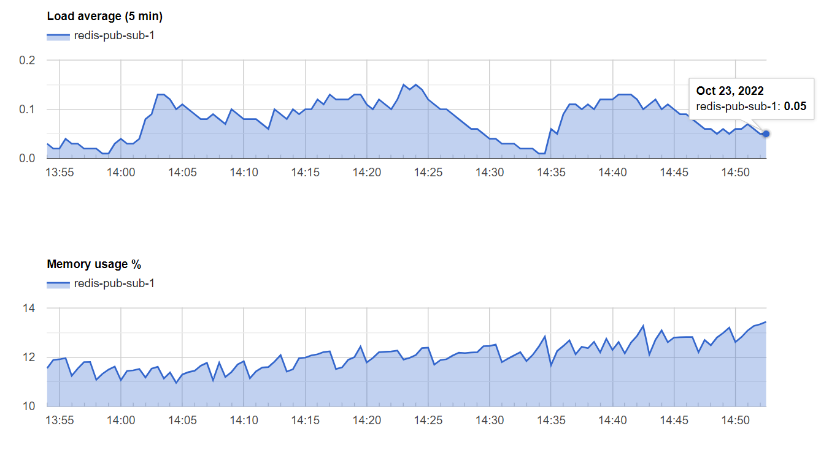
Redis Metrics

